Slide 1



Components of a Computer
System
Prepared By:
Asst. Prof. Jyotsnarani Tripathy

Slide 2

Computer is a programmable machine that receives input, stores and manipulates data, and provides output in a useful format.
Computer was used as an electronic device that allows inputting data and having it stored, processed, or otherwise manipulated quickly and efficiently.
A machine capable of following instruction to alter data in a desirable way and to perform at least some of these operations without human intervention.
◻
◻
◻

Slide 3
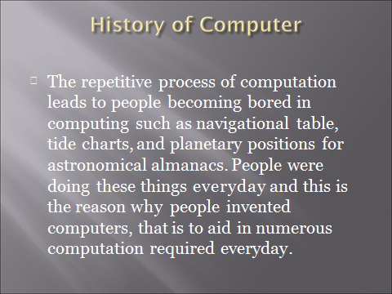
◻
The repetitive process of computation leads to people becoming bored in computing such as navigational table, tide charts, and planetary positions for astronomical almanacs. People were doing these things everyday and this is the reason why people invented.

Slide 4
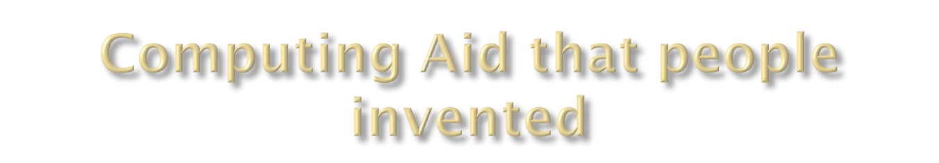
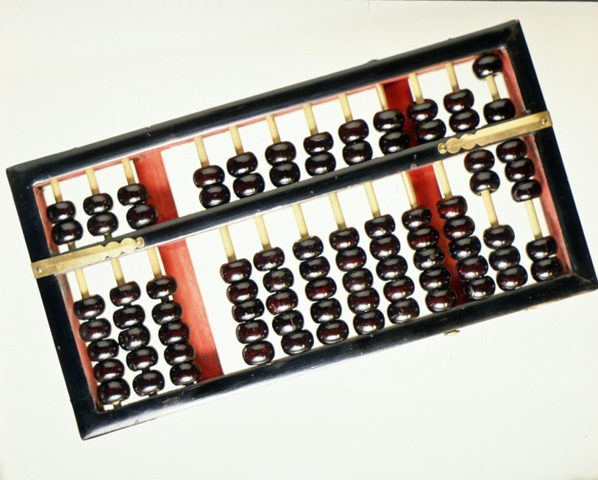
The Abacus
○ The first computing aid that were used to help them in their computation.
◻

Slide 5

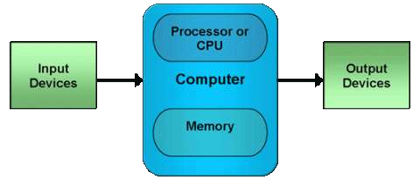


Basic components of a computer are :

Slide 6
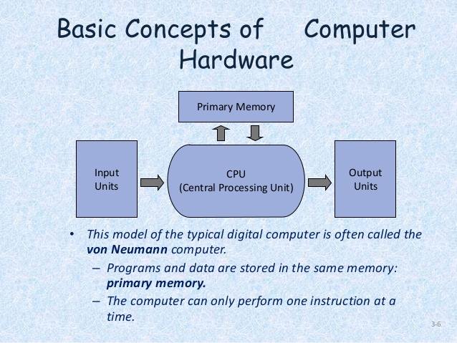

Slide 7


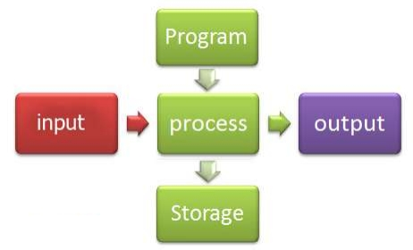
Computer Systems
A computer system is
one that is able to
take a set of inputs,
process them, and
create a set of
outputs. This is done
using a combination
of hardware and
software.

Slide 8

1. Input Unit
Input is any data or instructions entered into the memory of a computer
Any hardware component allows user to enter data and instructions in to a computer.

Slide 9

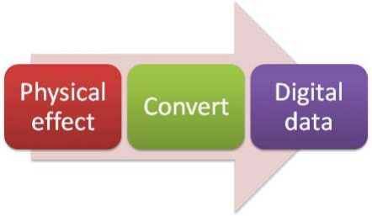
Input Devices
The purpose of an input device is to provide data in a computer system ready for processing.

Slide 10

Input Device
An input device is hardware that allows data to be entered into a computer.
Manual Input | Automatic Input
Keyboard | Barcode reader
Mouse | Sensor
Microphone | Magnetic stripe reader
Scanner | Optical mark reader (OMR)

Slide 11
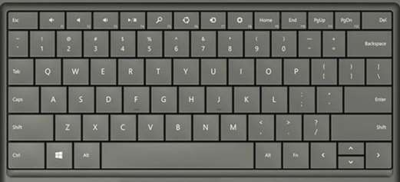
Keyboard
Used to enter information into the computer and for giving commands.
A standard computer keyboard is called a QWERTY keyboard

Slide 13
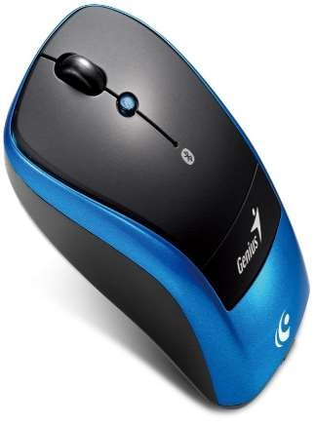
Ball Mouse
An input device operated by rolling its ball across a flat surface.The mouse is used to control the on- screen pointer by pointing and clicking, double- clicking, or dragging objects on the screen.

Slide 14
Optical Mouse
It is an advanced computer pointing device.
It uses Light-Emitting Diode(LED) in
place of the traditional mouse ball.
Movement is detected by sensing changes in reflected light.

Slide 15




2. Output Unit
The job of output unit is just the reverse of that of an Input Unit.
It supplies information and results of computation to the outside world.
Monitor and Printer are the most common Output Devices which are used.

Slide 16

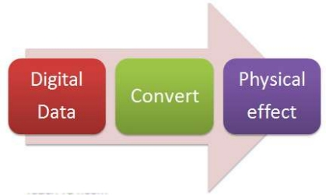
Output Devices
Output is the stage where the information obtained by the processing is presented to the user in a suitable format. Examples include;
• A printout of exam grades
• A digital display on a petrol pump
• A sound from a smoke alarm

Slide 17
Output Devices
A storage device is hardware that allows data to be saved, long-term, after it has been inputted into the computer. Examples include;
• Monitor
• Printer
• Projector
• Speakers

Slide 18
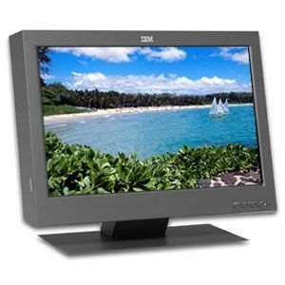
Monitor
A display screen is used to provide “output” to the user. It is where you can view the information you are working on.

Slide 19
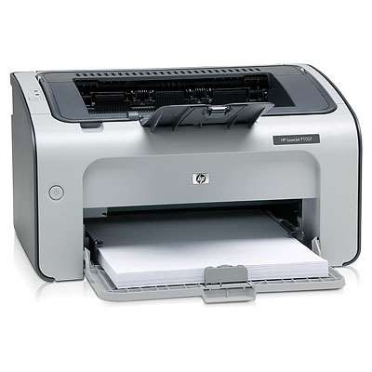
Printer
An output device that produces a hardcopy of the information.
Information to the user is in printed form.

Slide 20

3. Memory / Storage Devices
All computer need to store data.
Data is stored temporally while program is running
– Main Memory.
To store data for long-term, to preserve programs and data
while not in use – Backing Storage.
Primary Memory and Secondary Memory

Slide 21






Primary Memory
Temporary area for holding data.
To store the program currently being executed
To hold data produced while the programe is running.Primary Memory are of two types
  RAM &
  ROM

Slide 22

1.RAM(Random Access Memory)
Major portion of the Primary Memory
Memory that is used by the program in execution
If the computer gets turned off, RAM will lose all the data.
Static RAM & Dynamic RAM

Slide 23
Static RAM
The memory retains as long as power remains applied.
Uses Flip Flop circuitory.
Is more faster.

Slide 24
Dynamic RAM
Need continues Refreshing in order to maintain the data.
It uses transistors and capacitors in circuits
Slow and consumes more power

Slide 25
2.ROM (Read Only Memory)
Memory which we can only read but cannot write on.
Non-volatile.
Used to store some firmware programs.
PROM – Programmable Read Only Memory
EPROM – Erasable and Programmable read Only Memory.
EEPROM – Electrically Erasable and Programmable read Only Memory.

Slide 26

Storage
A storage device is hardware that allows data to be saved, long-term, after it has been inputted into the computer. Examples include;
• Hard drive
• DVD
• CD
• Flash memory (USB)

Slide 27

Storage Devices
The purpose of a storage device to store data and software for later use. The storage device will make some use of physical effect to represent the data. • CD, DVD, Blu-Ray – a laser burns dark pits onto the medium.
Each pit is a binary digit.
• Hard drives and magnetic tape use magnetic domains to represent data.
• Flash drive use electric charge to store the data
A primary storage device is the main computer storage device, and a secondary device is one where you can also store files, but is not the main storage you use.

Slide 28
Secondary Memory
Permanent memory of the system.
More storage capacity.
It is the Backing Store.
Ex-Magnetic Disk & Optical Disk

Slide 29
Magnetic Disc
Stored data in the form of Magnetic directions.
Hard Disk & Floppy Disk

Slide 30
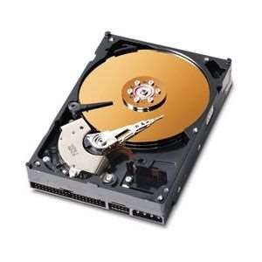
Hard Disk
Access to data is far faster than access to data in floppy disks.
Read/Write Head is positioned close to the disk.
Disk is attached to a spindle.
Spindle is rotated by a motor.
Speed of disk depends on the speed of motor.

Slide 31
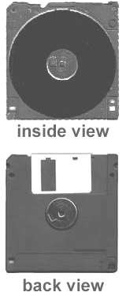
Floppy Disk
Consists of a plastic disk coated with iron oxide.
Disk access mechanism is arranged as a hardware unit called disk drive.
Drive contains motor, Read/Write Head etc.
Head comes in contact with the disk through the data access area.
Disk is rotated to pass the sectors through the head.

Slide 32



















Optical disk
It is an electronic storage medium.
Read operation is done using low powered laser beam.
A laser read the dots and then the data is converted to an electrical signal .
The output form of this devise is in audio and visual format
CD-ROM – Compact Disk-Read Only Memory.
CD – R – Compact Disk – Recordable.
CD-RW – Compact Disk – Rewritable
DVD – ROM – Digital Versatile Disk – Read Only Memory
DVD – RAM - Digital Versatile Disk – Random Access Memory

Slide 33

4. Processor Or CPU
The CU and ALU are jointly known as CPU.
Brain of the computer.
Perform data processing operations.
Control the working of the entire system.
Arithmetic and Logic Unit (ALU) & Control Unit(CU)

Slide 34
Arithmetic and Logic Unit ( ALU )
Place where the actual execution of the instructions take place during the processing operations.
All calculations are performed here.
It consists of circuits that perform arithmetic as well as logical operations.

Slide 35
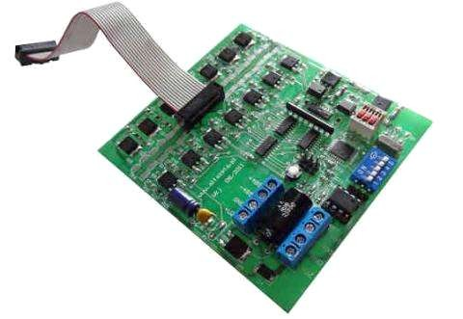
Control Unit
It act as a central nervous system for the other components of the computer.
It manages and coordinates the entire
computer system.
It get information from the main memory
It issues signal to control every other units of the system.

Slide 36

Hardware
Hardware are the physical components of a computer – eg the input devices, output devices, primary storage (memory) and secondary storage (backing store), Central Processing Unit etc. Note that input and output devices are collectively known as peripherals.
External Hardware | Internal Hardware
Monitor | Hard drive
Printer | CPU
Keyboard | Fan
Mouse | Motherboard
Microphone | Sound card

Slide 37

Software
Software are the sets of instructions/ programs that are loaded into the memory of the computer in order to perform a task or to control the operation of the computer.
Systems Software | Application Software
Operating systems | Word processors
Utilities | Web browsers
User interface | Game applications

Slide 38
Why Should Learn About Software?
Computer software, or simply software, is that part of a computer system that consists of encoded information or computer instructions, in contrast to the physical hardware from which the system is built.
Personal tasks using software.
Keeping a budget
Internet research
Games
Music
PerPersonal tasks using softPersonal tasks using software.
◆ Keeping a budget
◆ Internet research
◆ Games
◆ Music

Slide 39
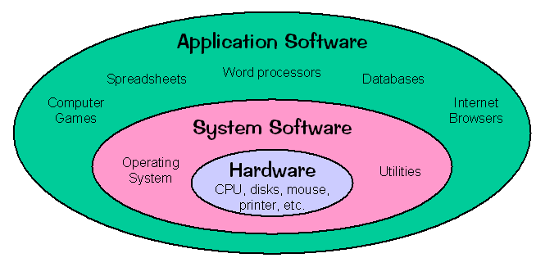
System Software Types of SoftwareApplication Software

Slide 40
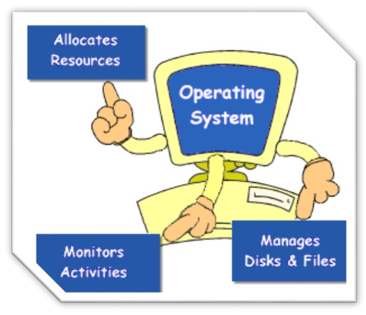
System Software:
System Software includes the Operating System and all the utilities that enable the computer to function
System Software includes the Operating System and all the utilities that enable the computer to function
Example : Operating Systems, Compiler, Loader, Linker, Interpreterystm and all the utilities that enable the computer to function

Slide 41
Types of systems software
Operating systems
Utility programs

Slide 42
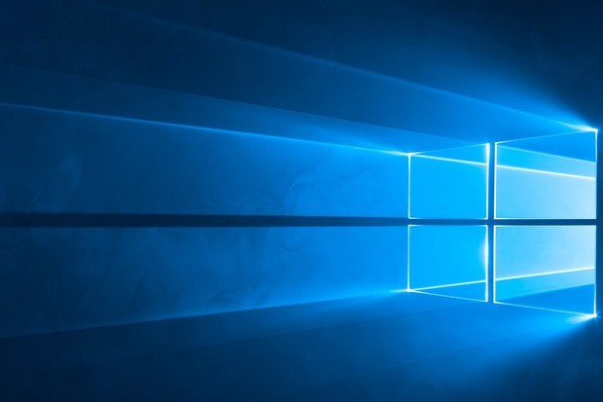
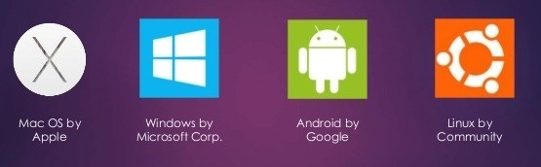
Operating System:
Operating system (OS): set of programs that controls the computer hardware and acts as an interface with application programs.
Operating System is a software, which makes a computer to actually work.
It is the software the enables all the programs we use.
Examples: Windows, Linux, Unix and Mac OS, etc.,

Slide 43
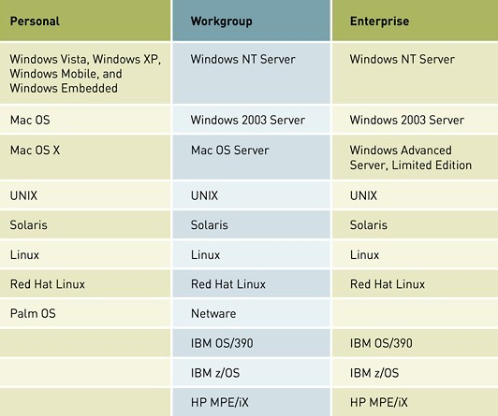
Current Operating Systems
Popular Operating Systems Cross All Three Spheres of Influence

